Slide 1
Lead User Guide:
Applicant Manager
Updated: 05/11/2018
Notes:
This is a guide for the Lead Applicant Manager Role. Please note that the Applicant Manager Tool is available by invitation only, and the Lead team must be contacted to activate this role for the user.
Slides 2-8 will be a closer look at the features of the Applicant Manager role. Slides 9-13 will outline the process of submitting an Individual application and using a payment code to pay for the application.

Slide 2
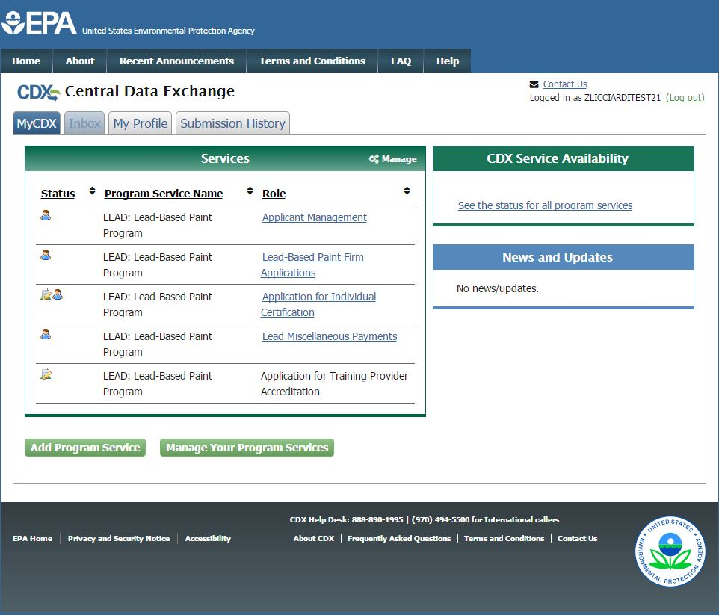
MyCDX Page
Notes:
The Applicant Manager Role is only accessible to users who have been granted access. It can be accessed through the MyCDX Page.

Slide 3
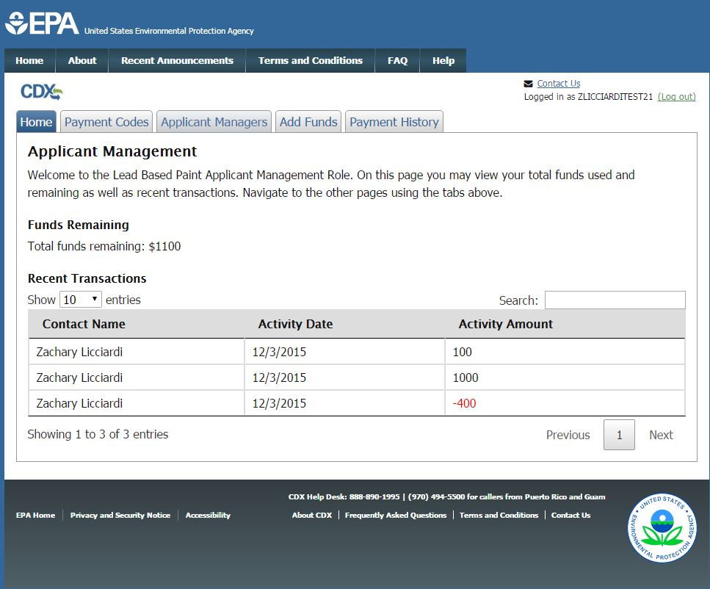
Applicant Manager Guide
Notes:
Once you access the Applicant Manager Role from the Home Page, your recent transactions and funds are displayed.

Slide 4
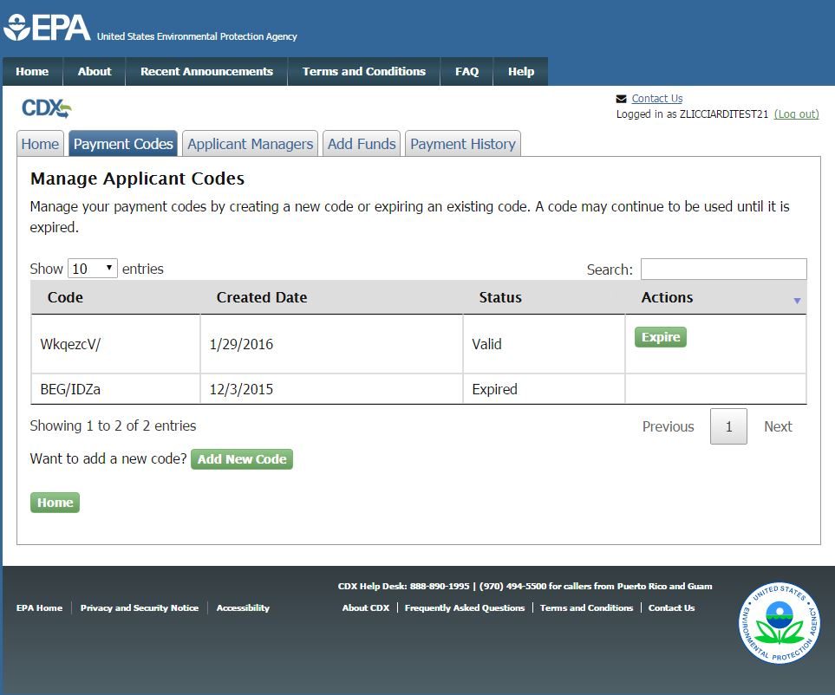
Applicant Manager Guide
Notes:
Click on the “Payment Codes” tab to access the Payment Codes Page. Here you can create new payment codes using the “Add New Code” button. You can also expire the payment codes using the “Expire” button. Individual users would be able to use the payment codes until they expire.

Slide 5
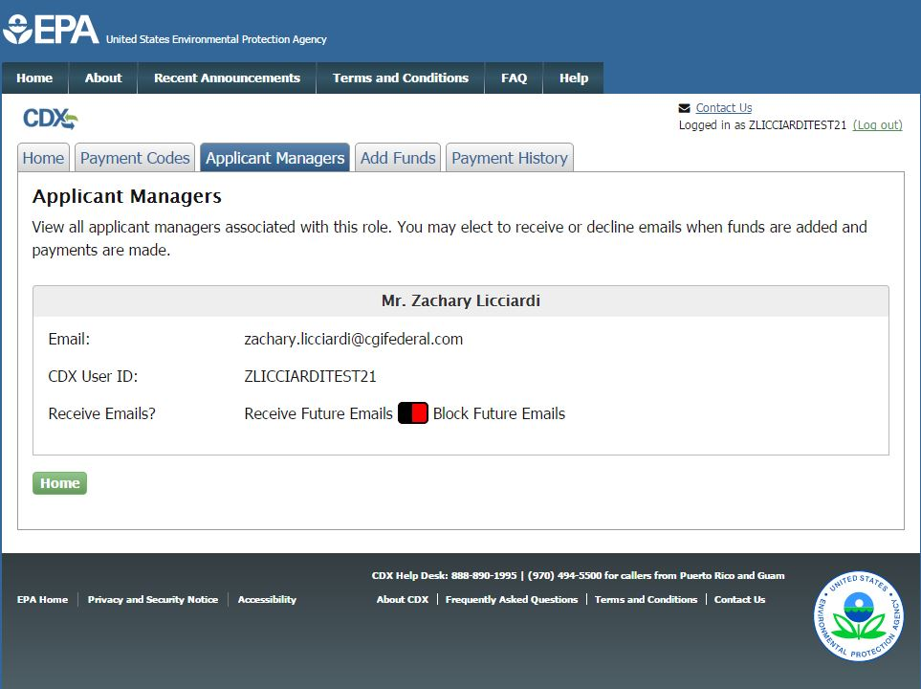
Applicant Manager Guide
Notes:
Click the “Applicant Managers” tab to access the Applicant Managers Page. Here you can view the other applicant managers that are associated with your account and elect whether or not you would like to receive emails. You will receive emails whenever an applicant manager adds funds or an individual user uses a payment code.

Slide 6
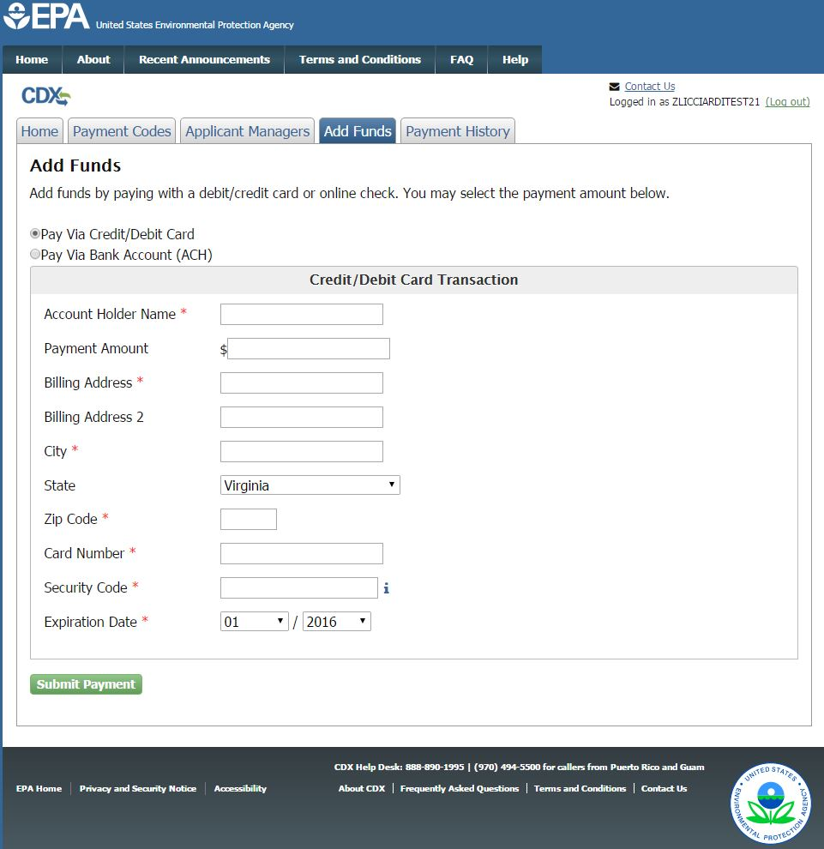
Applicant Manager Guide
Notes:
Click the “Add Funds” tab to access the Add Funds Page. Here you can add funds to your account which will be charged when a payment code is used.

Slide 7
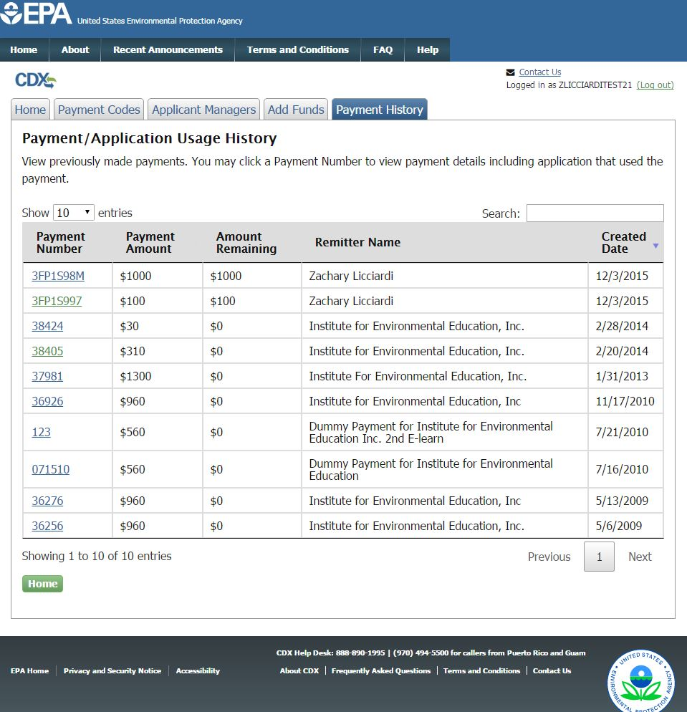
Applicant Manager Guide
Notes:
Click the “Payment History” tab to access the Payment History Page. Here you can view all payments that have been made in your account whether funds were added or removed.

Slide 8
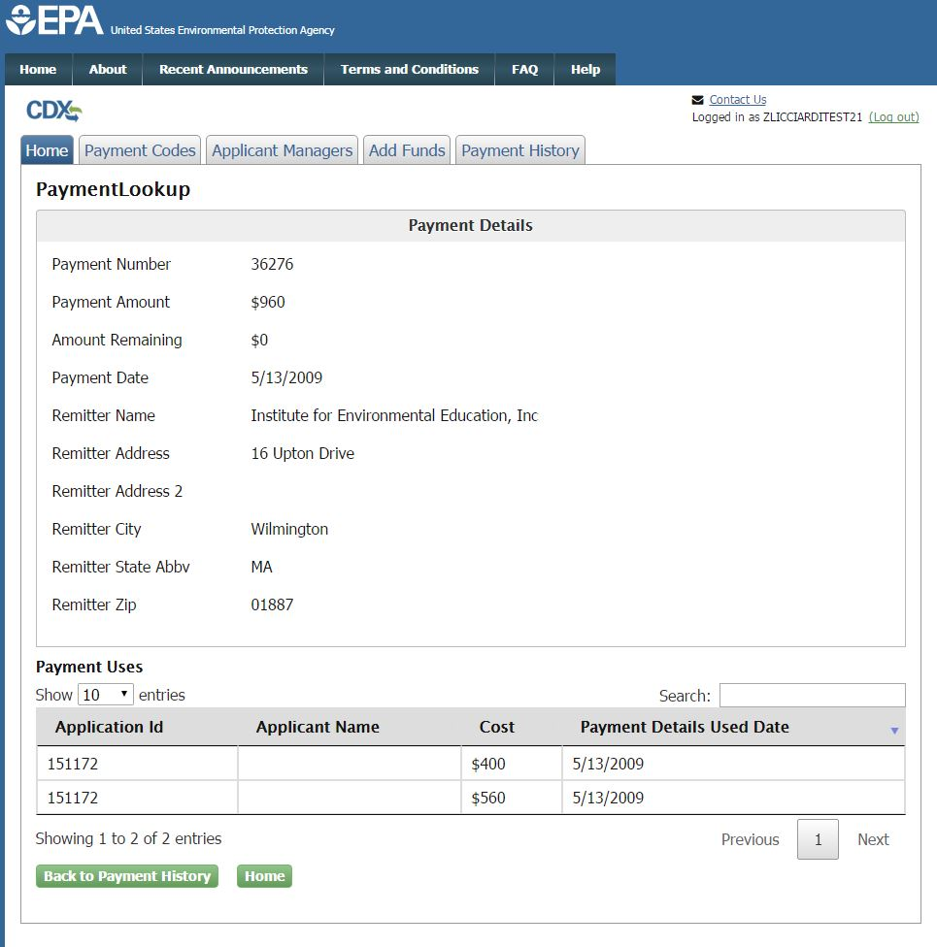
Applicant Manager Guide
Notes:
Click the payment number link tab to access the Payment Details Page. Here you can view the applications that used the payment.

Slide 9
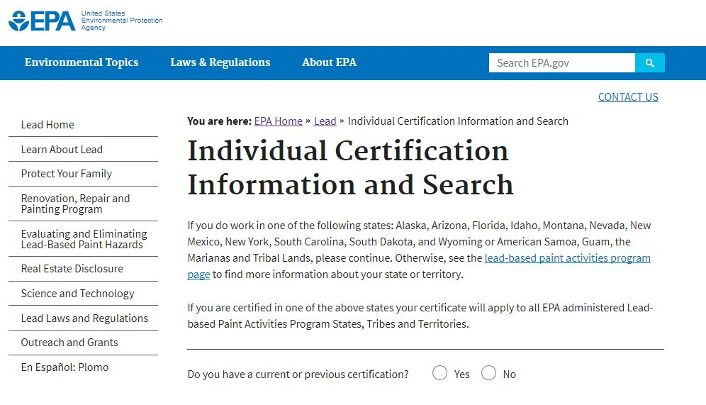
Individual Certification Search
Notes:
Here is the public site where individual users can access the individual application. They can enter a new initial application by selecting “no” and clicking the “Enter New Application” button. If they wish to recertify, request a replacement, or amend their certificate they will have to search for their certification using the search criteria.
https://cfpub.epa.gov/flpp/pub/index.cfm?do=main.individualSearch

Slide 10
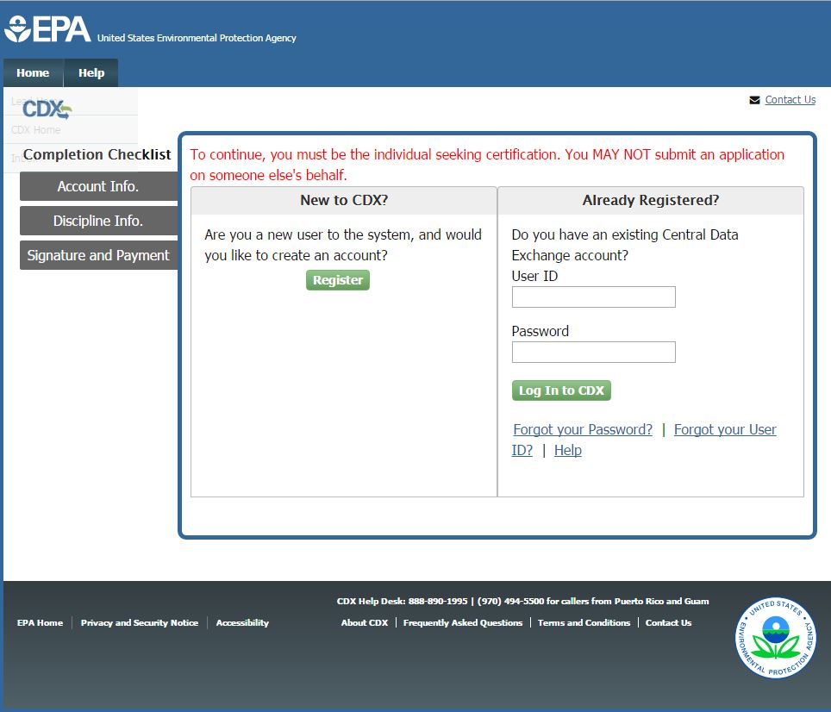
CDX Login Page
Notes:
From there they will be taken to CDX and asked to log in or register a new account. If they already have an account they should log in by entering their username and password.

Slide 11
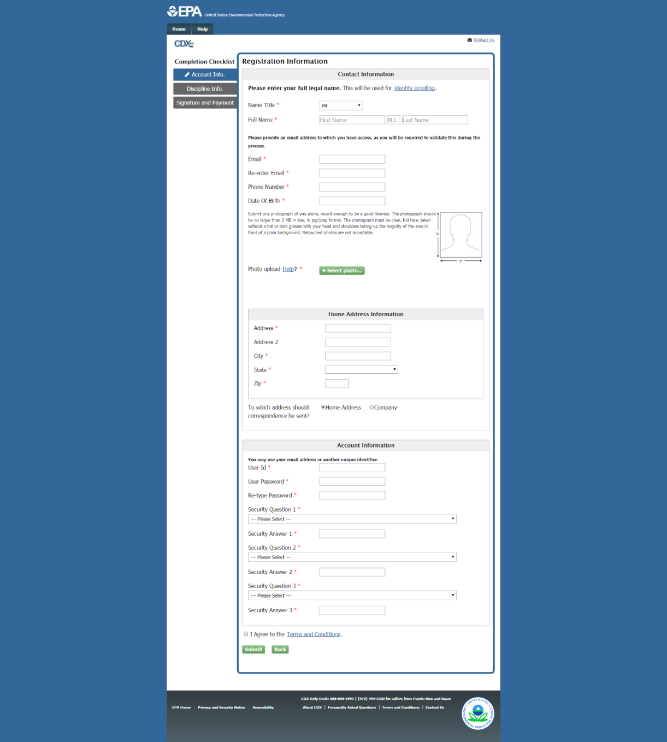
Individual Application Page
Notes:
The user will be taken to the Account Information Page. They will enter their account information as well as their passport photograph.

Slide 12
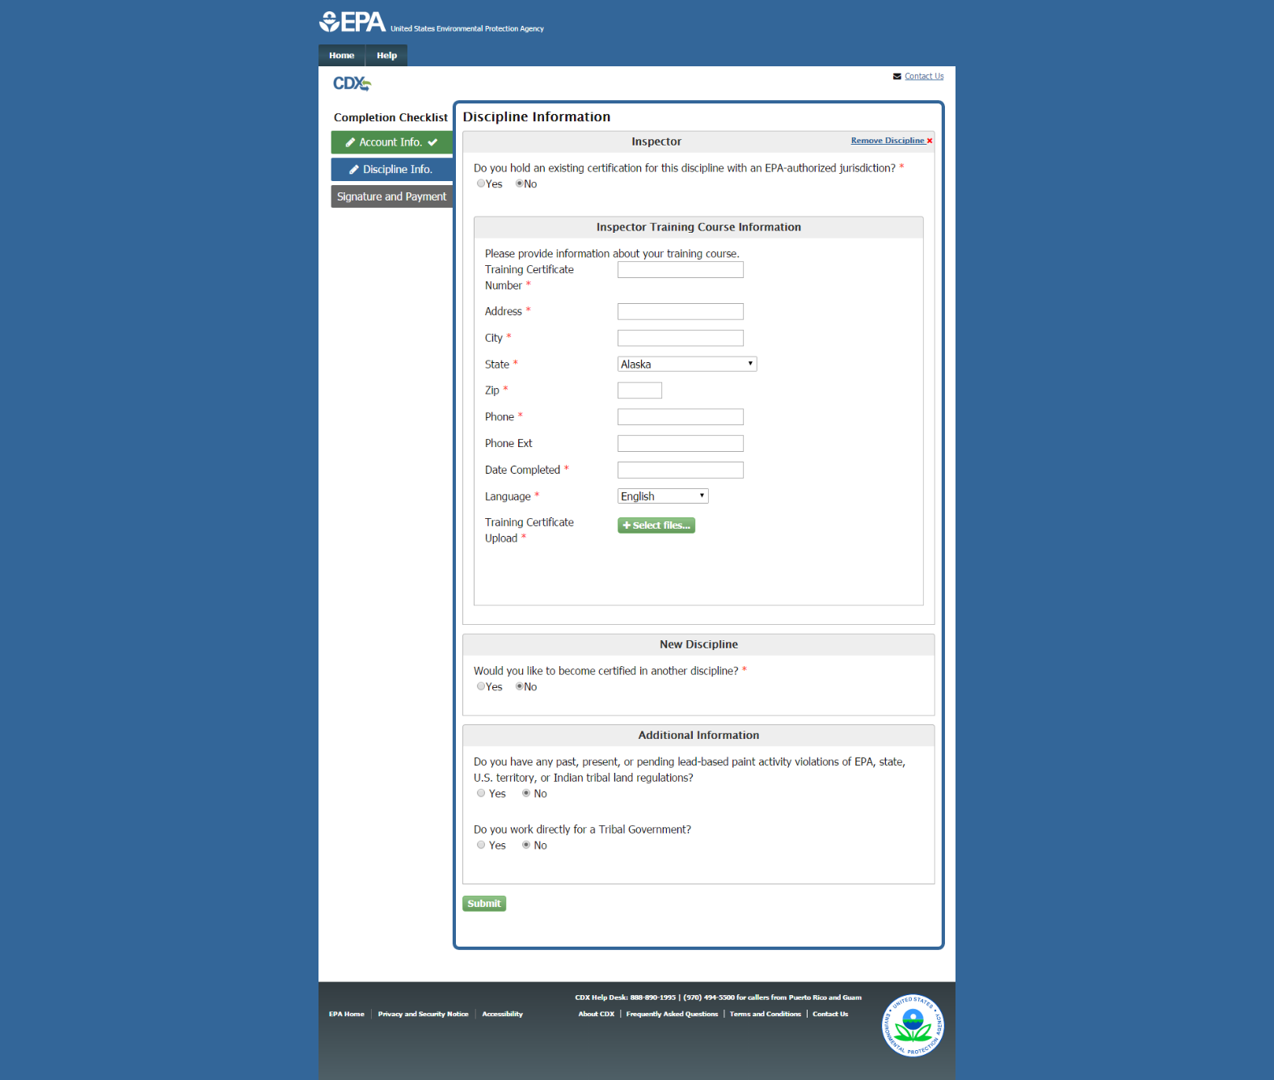
Individual Application Page
Notes:
Click the "Submit” button and the user is taken to the Discipline Page. Here they can enter their discipline information.

Slide 13
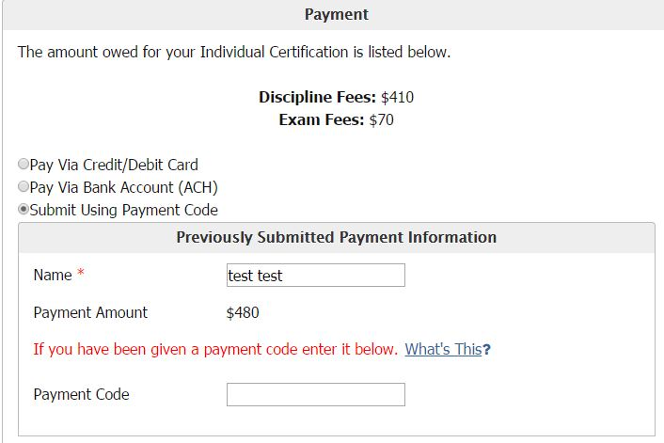
Individual Application Payment
Notes:
The user clicks the “Submit” button and is taken to the Review and Payment Page. Here they can review their information and submit payment. To submit using a payment code, the user must select the “Submit Using Payment Code” radio button. Here they must enter their name and their given payment code. The user then clicks to sign the certification and clicks the ‘’Sign and Pay” button to submit their application. The account associated with the payment code will be charged.

